Slide 1
Update
LabTI Universitas Gunadarma

Slide 2
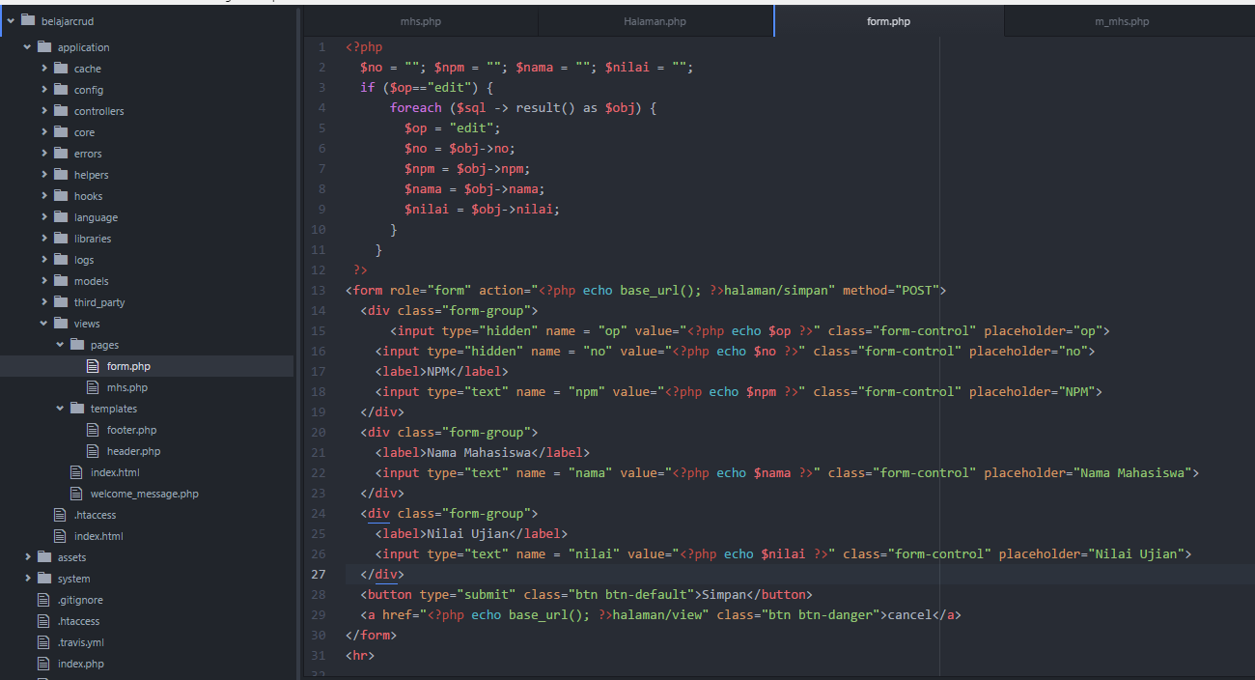
form.php

Slide 3
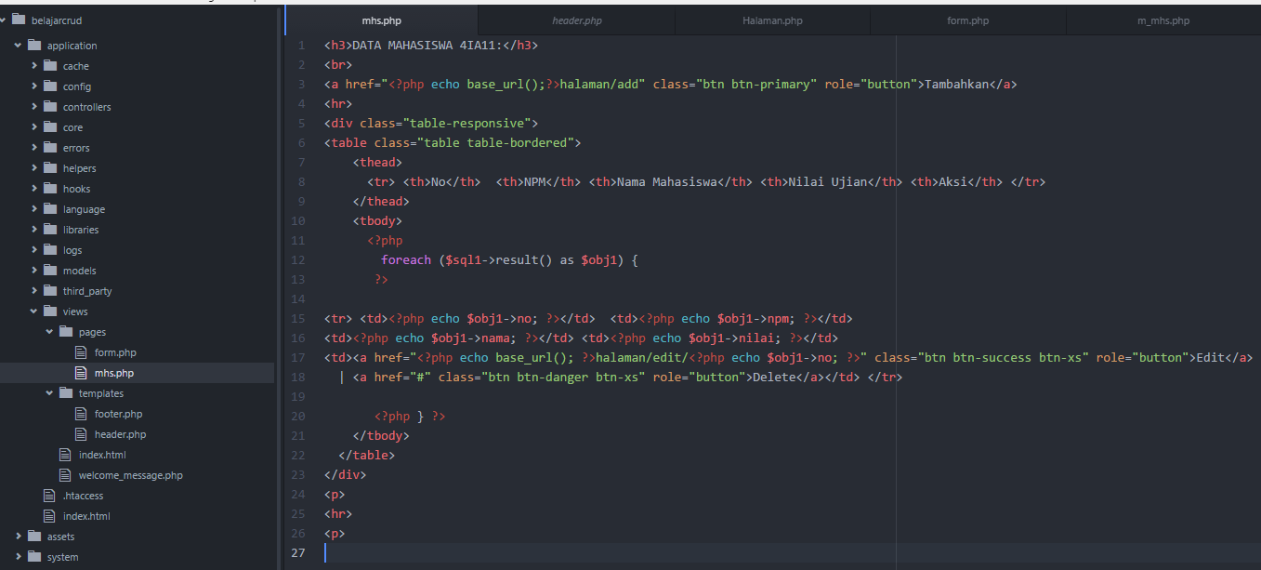
View (mhs.php)

Slide 4
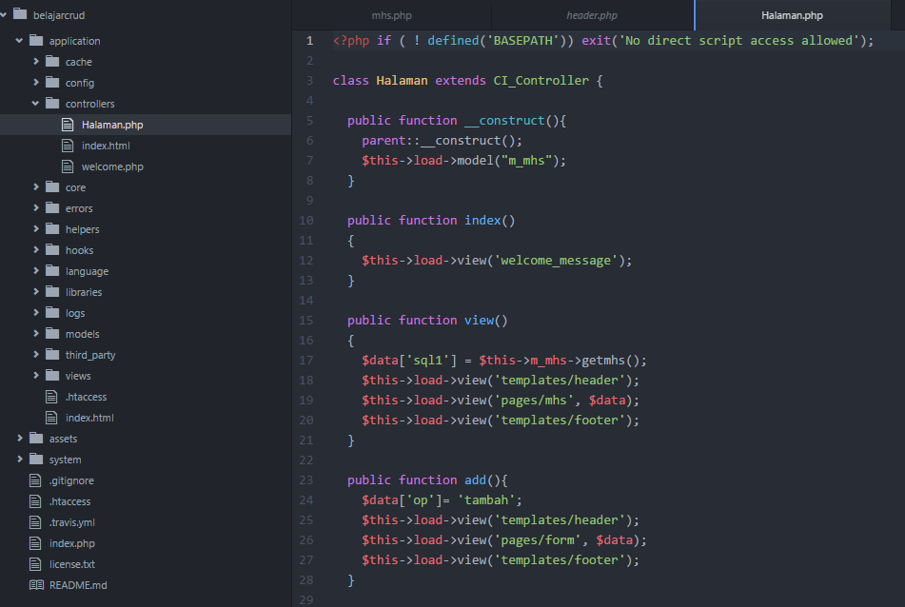
Controllers (halaman.php)

Slide 5
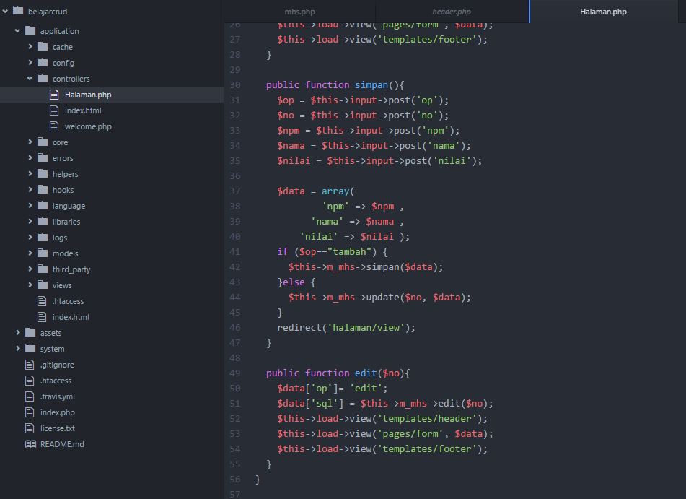

Slide 6
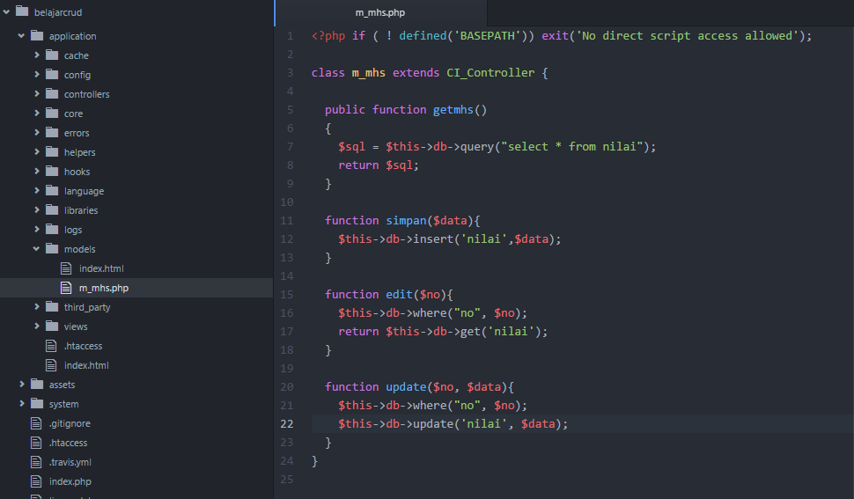
Model (m_mhs.php)

Slide 7
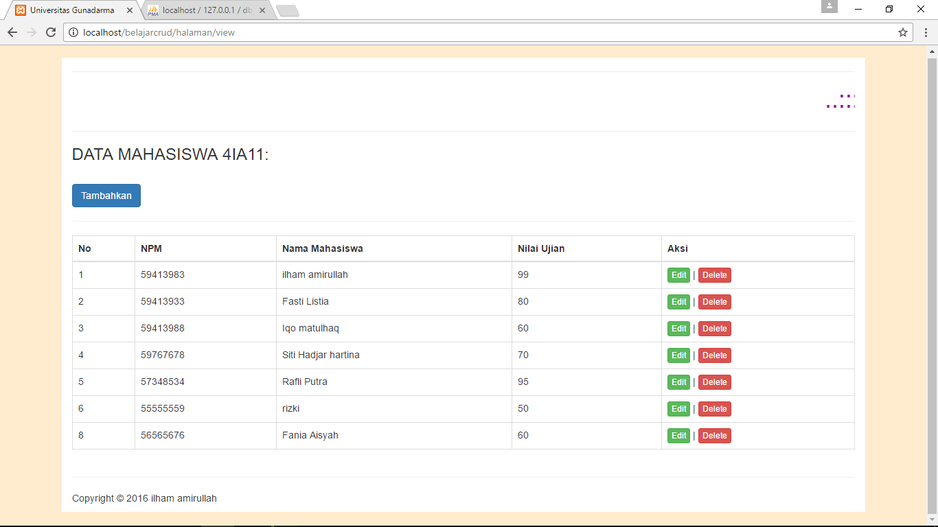

Slide 8
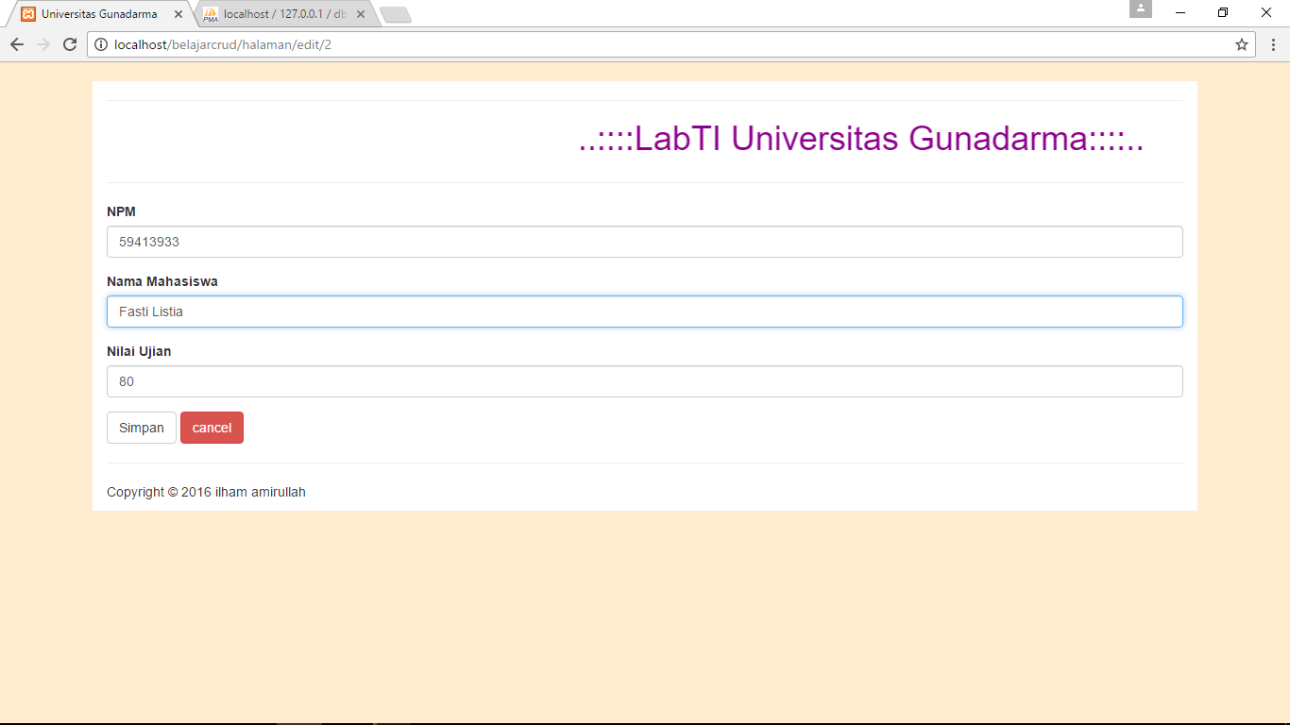

Slide 9
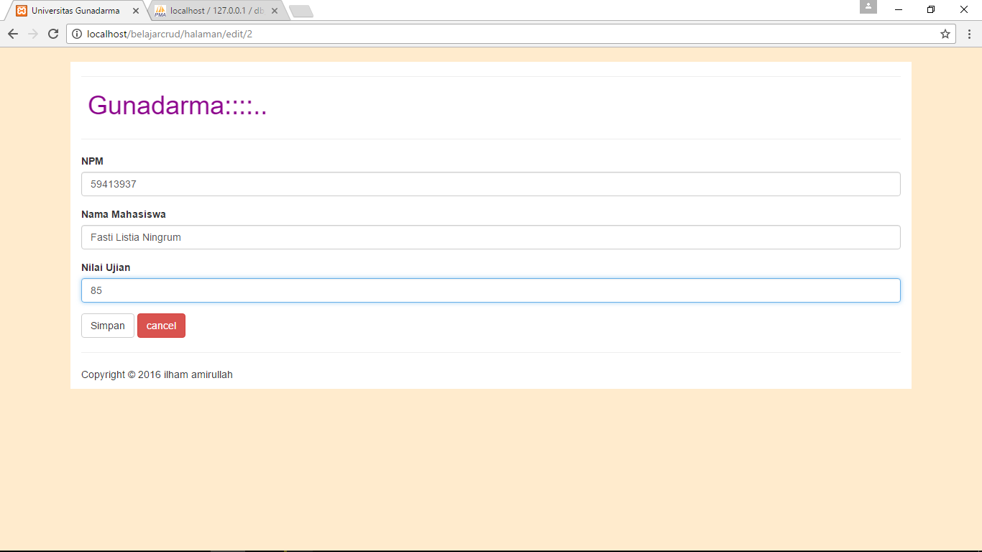

Slide 10
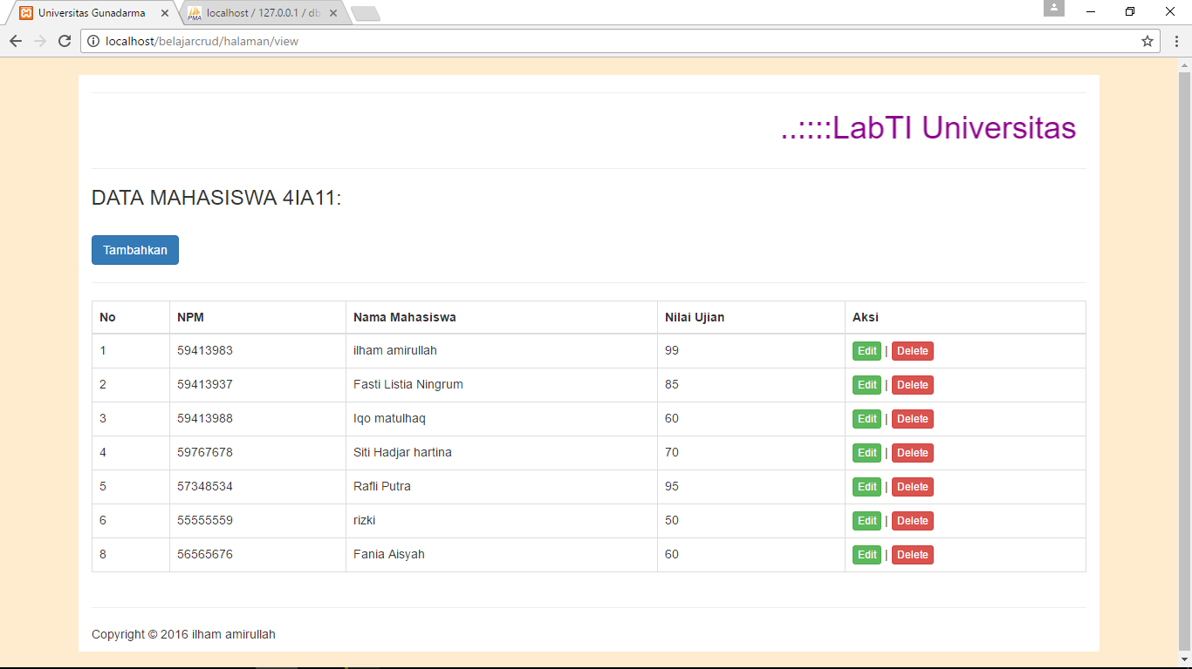

Slide 11
Referensi
https://www.youtube.com/watch?v=NKhQp_zWuWc&list=PLTB1091jq_WuYfC6J3FNQKTc4TSDrnBP4

